Slide 1

Exercise 3 Activity

Slide 2
Exercise 3
How are weight-at-age and maturity-at-age changing over time?
What parameter(s) would you use to represent how productivity is changing over time?
How would you describe the change in productivity over time?
Describe the approach that you would use to define the uncertainty in stock status

Slide 3
Exercise 3
Q1
Approaches:
Pros
Cons
Q2
Preferred approach:
Best practice criteria?
Assumptions?

Slide 4
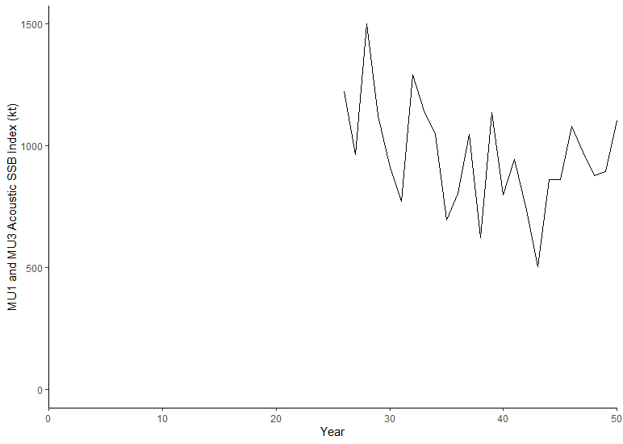
Exercise 3
Q3
Add plot here from R
Q4
Stock status in Year 20?
Stock status in Year 50?

Slide 5
Exercise 3 Presentation Slide (to share at the workshop tomorrow)

Slide 6
Break Out Group Add Number
Indicator:
LRP:
Rationale:
Stock status year 20:
Stock status year 50:
Add plot here

